Slide 1
3XA3 POC Presentation
Maanav Dalal, Jessica Lim, Jay Mody

Slide 2
1. OBJECTIVES
II. Current Status
III. POC Demonstration
IV. Moving Forward
What we set out to accomplish for our POC
What we have accomplished to date
A demonstration of the lpm package
A conclusion of our presentation and time for your questions

Slide 3
Quick Summary
Lines Per Minute (lpm) is a command-line application written in python that allows individuals to practice their typing speed for code. The application is delivered through PyPi as a package and is strictly interfaced via the command line.

Slide 4
Proof of Concept Demonstration Plan / Objectives
Package Installation
Code Snippet Output & User Input
We must be able to install the lpm package from PyPy using the command:
pip install lpm
Then, we must be able to launch the CLI using:
lpm
Upon entry of the CLI tool, a single code snippet must be outputted, and the user can type the code snippet.
It is not yet required that the user input is tested against the code snippet, instead it is just important to demonstrate we can gather user input.

Slide 5
Current STatus
Package on PyPi
CLI Tool Launches
We were able to successfully reserve the ‘lpm’ package name, and it is on pypi here.
After installing, we can launch the tool as expected, using lpm in the command line.
Code Snippets
User Input
We currently have a library of 3 single-line code snippets which are randomly served to the user.
We also give the user the option to start over as many times as they want.
Currently, we can accept user input, and have a rudimentary implementation to allow for outputting of typing accuracy.

Slide 6
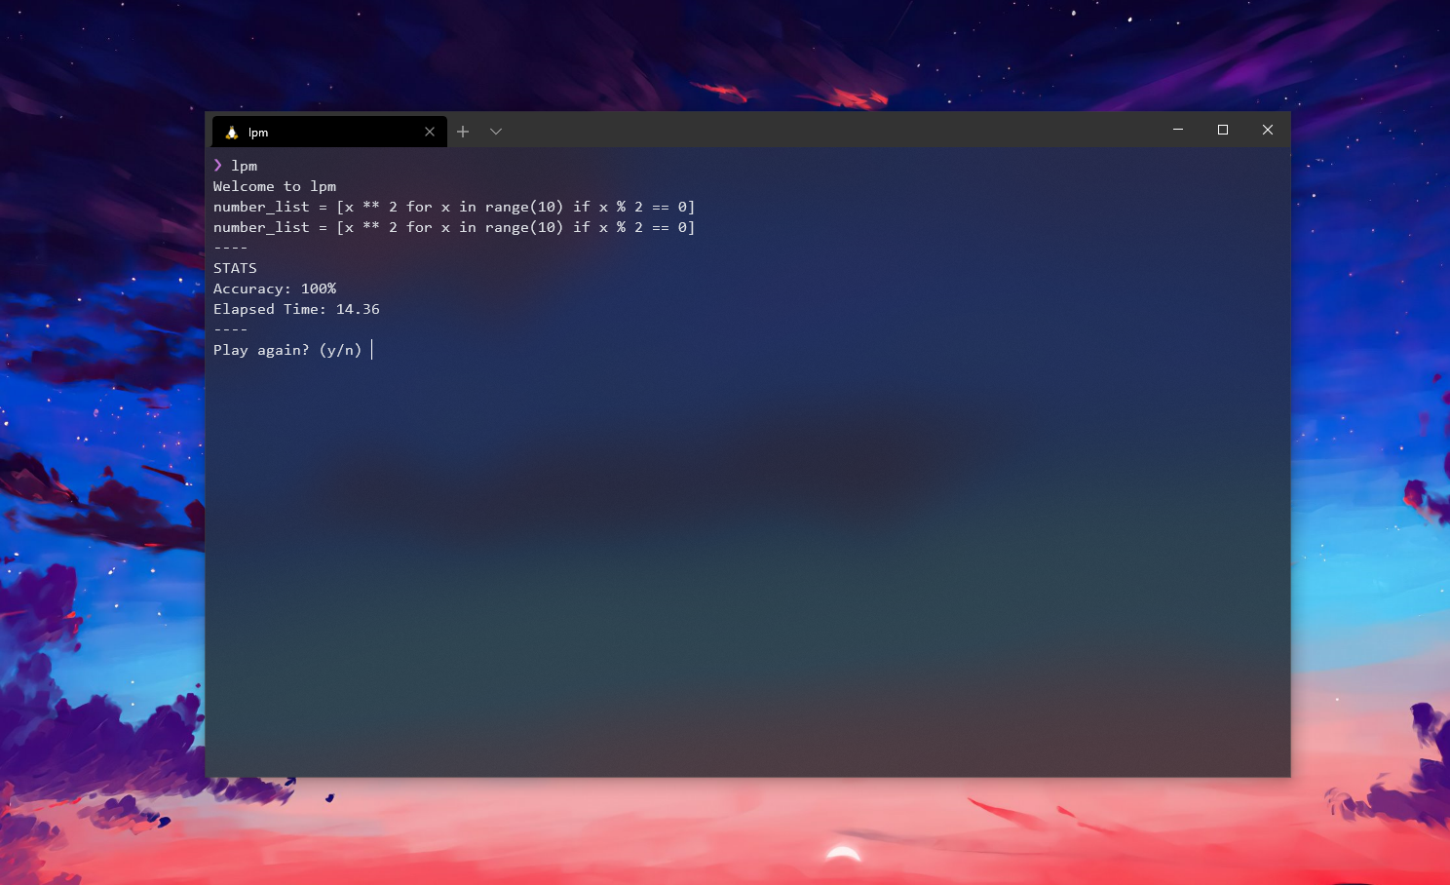
POC Live Demonstration

Slide 7
Moving Forward
UML
Modularization
Testing

Slide 8

Questions?

